Slide 1




University Institute of Engineering
Department of Computer Science & Engineering
COMPUTER ORGANIZATION & ARCHITECTURE
(23CST-204/23ITT-204)
ER. SHIKHA ATWAL
E11186
ASSISTANT PROFESSOR
BE-CSE

Slide 2
COMPUTER ORGANISATION & ARCHITECTURE
COMPUTER ARCHITECTURE is a set of rules and methods that describe the functionality, organization, and implementation of computer systems. It is the conceptual design and fundamental operational structure of a computer system. It encompasses the layout of the hardware, the design of the instruction set, and the techniques for data handling and processing. The objective is to outline a blueprint that ensures optimal performance and efficiency.
COMPUTER ORGANIZATION refers to the operational units and their interconnections that realize the architectural specifications of a computer. It involves the structural relations and the manner in which the components of the computer system are connected and work together.
While architecture defines a computer’s functionality, organization determines how this functionality is implemented. Both are essential to hardware design.

Slide 3
Computer Architecture | Computer Organization
Architecture describes what the computer does. | The Organization describes how it does it.
Computer Architecture deals with the functional behavior of computer systems. | Computer Organization deals with a structural relationship.
In the above figure, it’s clear that it deals with high-level design issues. | In the above figure, it’s also clear that it deals with low-level design issues.
Architecture indicates its hardware. | Whereas Organization indicates its performance.
As a programmer, you can view architecture as a series of instructions, addressing modes, and registers. | The implementation of the architecture is called organization.
For designing a computer, its architecture is fixed first. | For designing a computer, an organization is decided after its architecture.
Computer Architecture is also called Instruction Set Architecture (ISA). | Computer Organization is frequently called microarchitecture.

Slide 4
Computer Architecture | Computer Organization
Computer Architecture comprises logical functions such as instruction sets, registers, data types, and addressing modes. | Computer Organization consists of physical units like circuit designs, peripherals, and adders.
The different architectural categories found in our computer systems are as follows: Von-Neumann Architecture Harvard Architecture Instruction Set Architecture Micro-architecture System Design | CPU organization is classified into three categories based on the number of address fields: Organization of a single Accumulator. Organization of general registers Stack organization
It makes the computer’s hardware visible. | It offers details on how well the computer performs.
Architecture coordinates the hardware and software of the system. | Computer Organization handles the segments of the network in a system.
The software developer is aware of it. | It escapes the software programmer’s detection.
Examples- Intel and AMD created the x86 processor. Sun Microsystems and others created the SPARC processor. Apple, IBM, and Motorola created the PowerPC. | Organizational qualities include hardware elements that are invisible to the programmer, such as interfacing of computer and peripherals, memory technologies, and control signals.

Slide 5
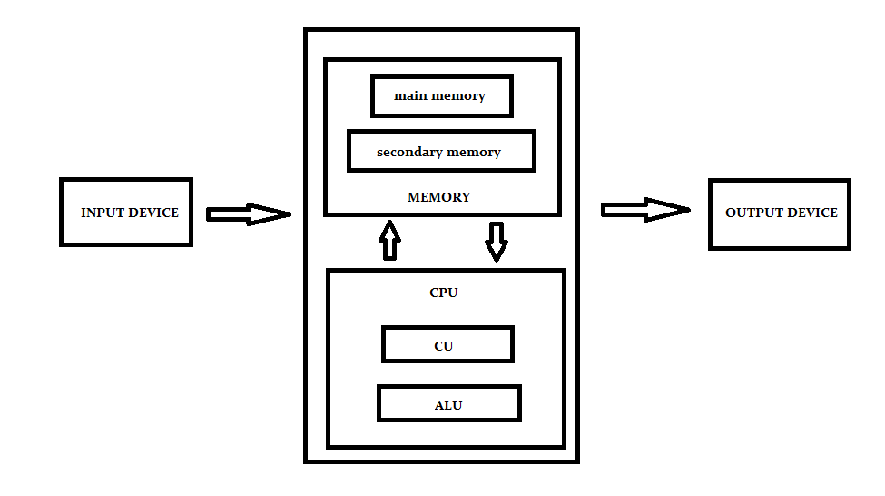
Digital Computer
A digital computer is a programmable machine which read the binary instruction and processes the data which are presented in binary form. Digital computers are different from analog computers in the sense that analog computer process the analog data. Here the term analog represents continuous data.
The digital computer takes the binary data at input, processes according to the set of instructions called program and produces the digital output.
Block Diagram of Computer

Slide 6
INPUT DEVICE
It is used to enter data and programs into a computer system. We input data and instructions into the computer. Ex- Keyboard, Mouse, Floppy disk, Scanner etc.
We give data, which is in raw form, process the data and convert it into information.
MEMORY
The Memory unit can be referred to as the storage area in which programs are kept which are running, and that contains data needed by the running programs. It enables a processor to access running execution applications and services that are temporarily stored in a specific memory location.
There are different types of memory in computer system.
Main Memory
Also called primary memory.
It is volatile i.e. the contents are lost if a power failure or a system crash occurs.
Computer programs must be in main memory to be executed.
Its size is small and it is expensive.
Ex: RAM
Main memory can be accessed directly. So, we want all the data to reside in main memory, which is not possible because of 2 reasons:
Main memory is usually too small to store all the needed programs and data permanently.
It is volatile and hence data is lost. So, we need secondary storage.

Slide 7
2. Secondary Memory
Most computers have secondary storage as an extension to main memory.
Main requirement is that it should be able to hold large quantities of data permanently.
Speed is slow.
Cost is low.
Ex: Hard disk drive (HDD), FDD (Floppy disk Drive), Pendrive etc.
Cache Memory
Fastest and most costly.
Frequently used data is copied into cache memory on a temporary basis.
When we need some information, we first check whether it is in the cache. If it is present, we use the information directly from the cache. If it is not, we use the information from the main memory, putting a copy in the cache memory assuming that it will be needed again.
CPU
Central processing unit commonly known as CPU can be referred as an electronic circuitry within a computer that carries out the instructions given by a computer program by performing the basic arithmetic, logical, control and input/output (I/O) operations specified by the instructions.
It is the heart of the computer.
It is a combination of control unit and ALU.

Slide 8
Control Unit
The control unit is a component of a computer's central processing unit that coordinates the operation of the processor. It tells the computer's memory, arithmetic/logic unit and input and output devices how to respond to a program's instructions.
The control unit is also known as the nerve center of a computer system.
It determines movement of electronic signals between the main memory and ALU as well as control signals between CPU and I/O devices.
Arithmetic & Logic Unit
Most of all the arithmetic and logical operations of a computer are executed in the ALU (Arithmetic and Logical Unit) of the processor. It performs arithmetic operations like addition, subtraction, multiplication, division and also the logical operations like AND, OR, NOT operations.
Controls the speed of the calculations.
OUTPUT DEVICE
The primary function of the output unit is to send the processed results to the user. Output devices display information in a way that the user can understand. Output devices are pieces of equipment that are used to generate information or any other response processed by the computer.
Output Unit of a computer provides the information and results of a computation to the outside world. Ex: Printers, Monitors, FDD, HDD.

Slide 9
INPUT-OUTPUT SUBSYSTEMS
Input and output (I/O) devices allow us to communicate with the computer system. I/O is the transfer of data between primary memory and various I/O peripherals. Input devices such as keyboards, mouse, card readers, scanners, voice recognition systems, and touch screens enable us to enter data into the computer. Output devices such as monitors, printers, plotters, and speakers allow us to get information from the computer.
These devices are not connected directly to the CPU. Instead, there is an interface that handles the data transfers. This interface converts the system bus signals to and from a format that is acceptable to the given device. The CPU communicates to these external devices via I/O registers. This exchange of data is performed in two ways. In memory-mapped I/O, the registers in the interface appear in the computer’s memory map, and there is no real difference between accessing memory and accessing an I/O device. Clearly, this is advantageous from the perspective of speed, but it uses up memory space in the system. With instruction-based I/O, the CPU has specialized instructions that perform the input and output. Although this does not use memory space, it requires specific I/O instructions, which implies that it can be used only by CPUs that can execute these specific instructions. Interrupts play a very important part in I/O, because they are an efficient way to notify the CPU that input or output is available for use. We will explore these I/O methods in detail in later chapters.

Slide 10
References
Reference Books:
J.P. Hayes, “Computer Architecture and Organization”, Third Edition.
Mano, M., “Computer System Architecture”, Third Edition, Prentice Hall.
Stallings, W., “Computer Organization and Architecture”, Eighth Edition, Pearson Education.
Text Books:
Carpinelli J.D,” Computer systems organization &Architecture”, Fourth Edition, Addison Wesley.
Patterson and Hennessy, “Computer Architecture”, Fifth Edition Morgaon Kauffman.
Reference Links:
https://youtu.be/cIHDV0HGH-Y?si=2fmhNL5KRjMGTjpi
https://youtu.be/4u5sUq96BOg?si=BF0bDtrfPyapEF9u
https://www.youtube.com/watch?v=oAneKttKjtA&list=PL5Rc9H5eTGY6MHqCKAarxhxqT7nipKgun

